Slide 1
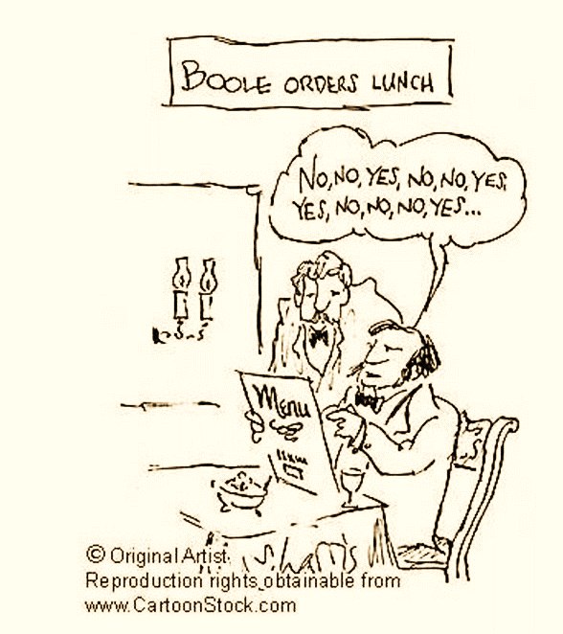
Satisfiability Problem
AIFA (AI61005) 2021 Autumn
Plaban Kumar Bhowmick

Slide 2
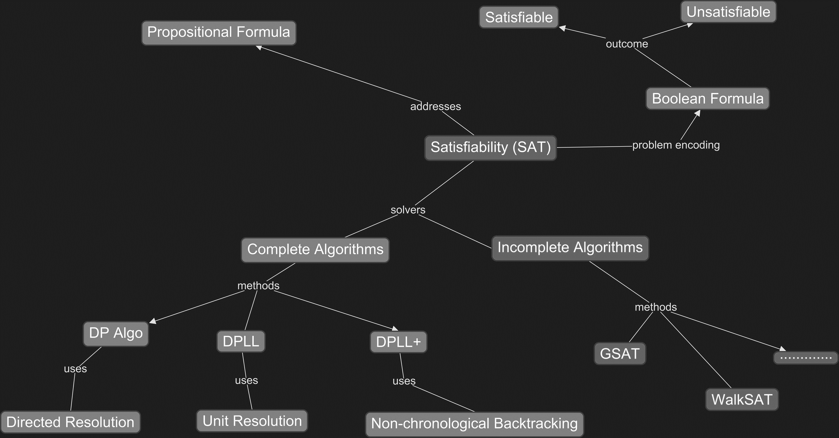
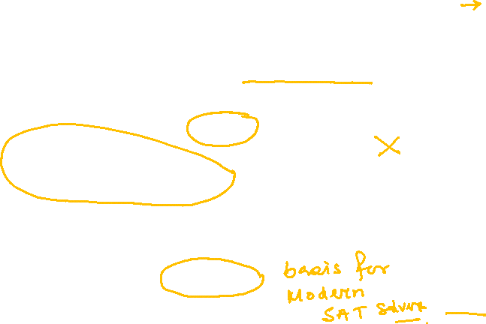

Slide 3
SAT: Why and What

Slide 4
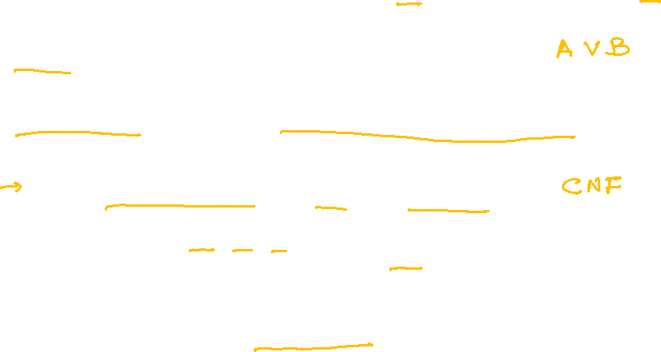
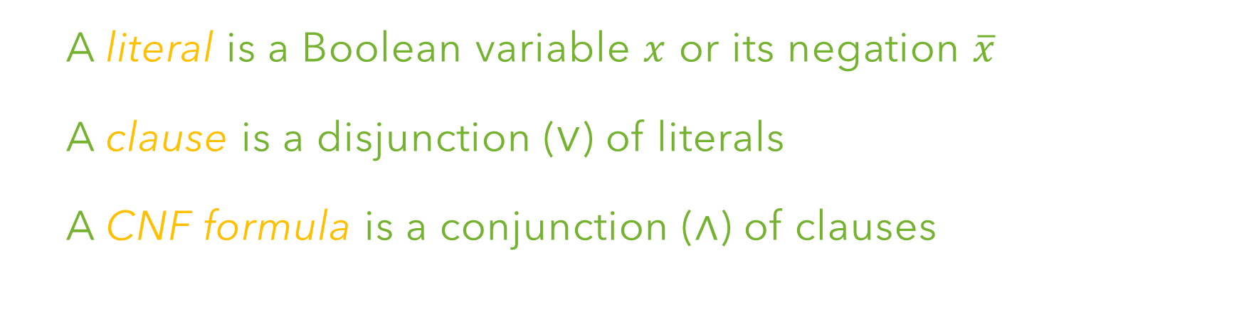



Propositional Logic
A literal is a Boolean variable $x$ or its negation $\overline{x}$
A clause is a disjunction ($∨$) of literals
A CNF formula is a conjunction ($∧$) of clauses
$$F=\left(x_{1}∨ \overline{x_{2}}∨\overline{x_{3}}\right)∧\left(x_{2}\right)∧(x_{2}∨ \overline{x_{3}})$$
$Vars\left(F\right)=\{x_{1}, x_{2},x_{3}$}
$Literals\left(F\right)=\{x_{1}, x_{2},\overline{x_{2}}, x_{3}$, $x_{3}$}
$Clauses\left(F\right)=\{\left(x_{1}∨ \overline{x_{2}}∨\overline{x_{3}}\right), \left(x_{2}\right)$, $(x_{2}∨ \overline{x_{3}})$}

Slide 5
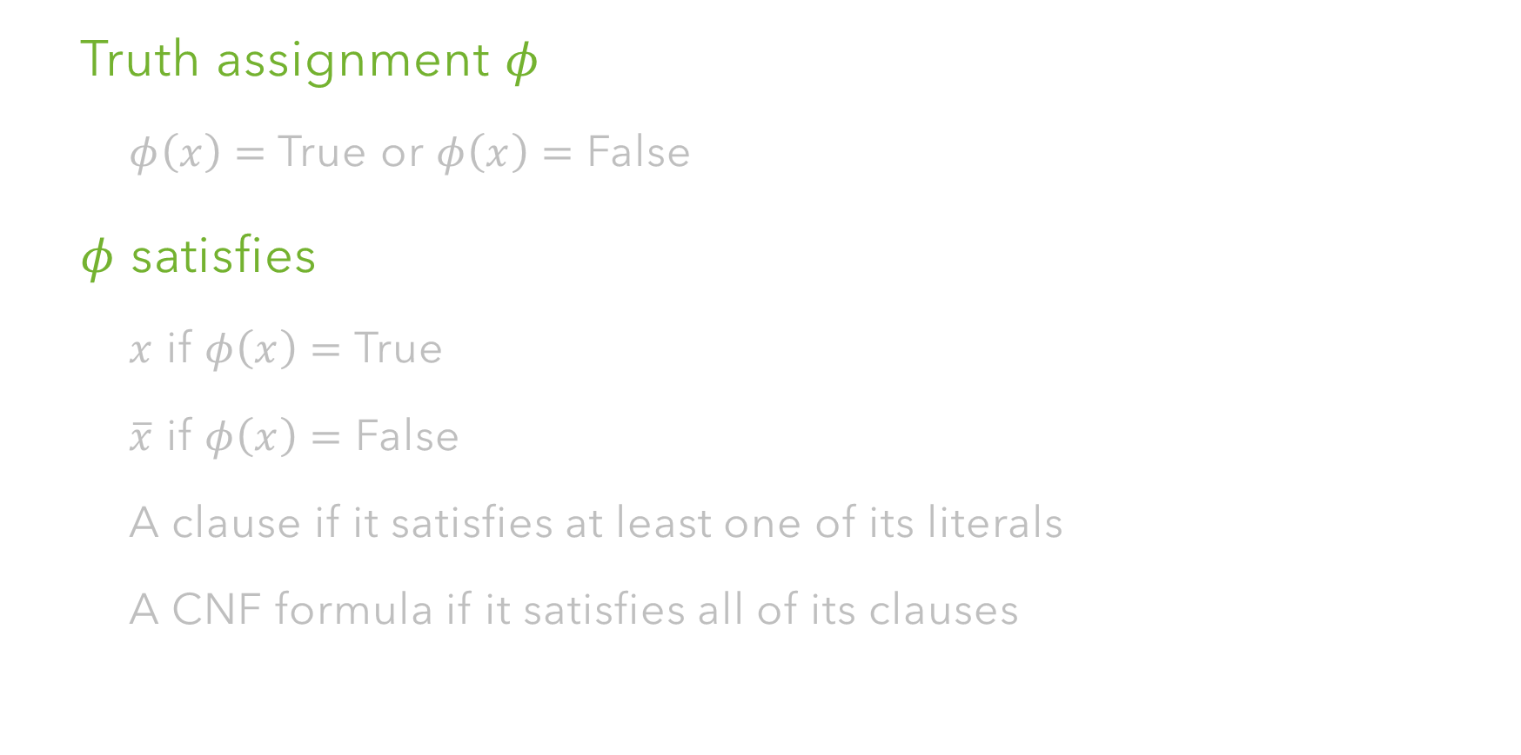
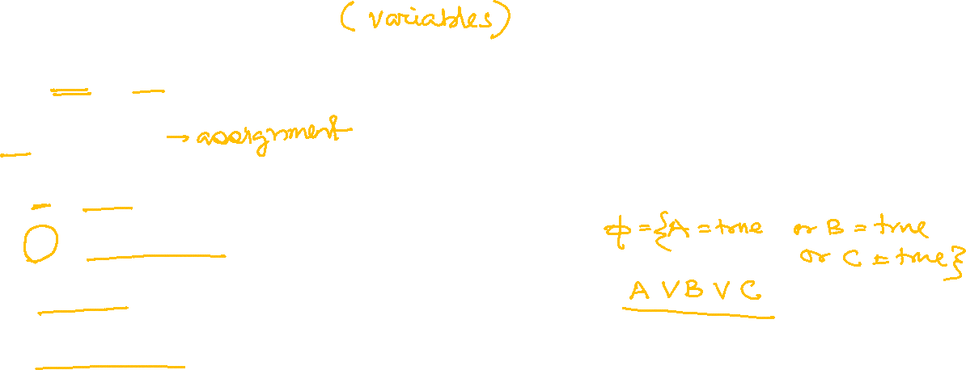
Satisfiability
Truth assignment $φ$
$φ\left(x\right)=$ True or $φ\left(x\right)=$ False
$φ$ satisfies
$x$ if $φ\left(x\right)=$ True
$\overline{x}$ if $φ\left(x\right)=$ False
A clause if it satisfies at least one of its literals
A CNF formula if it satisfies all of its clauses

Slide 6
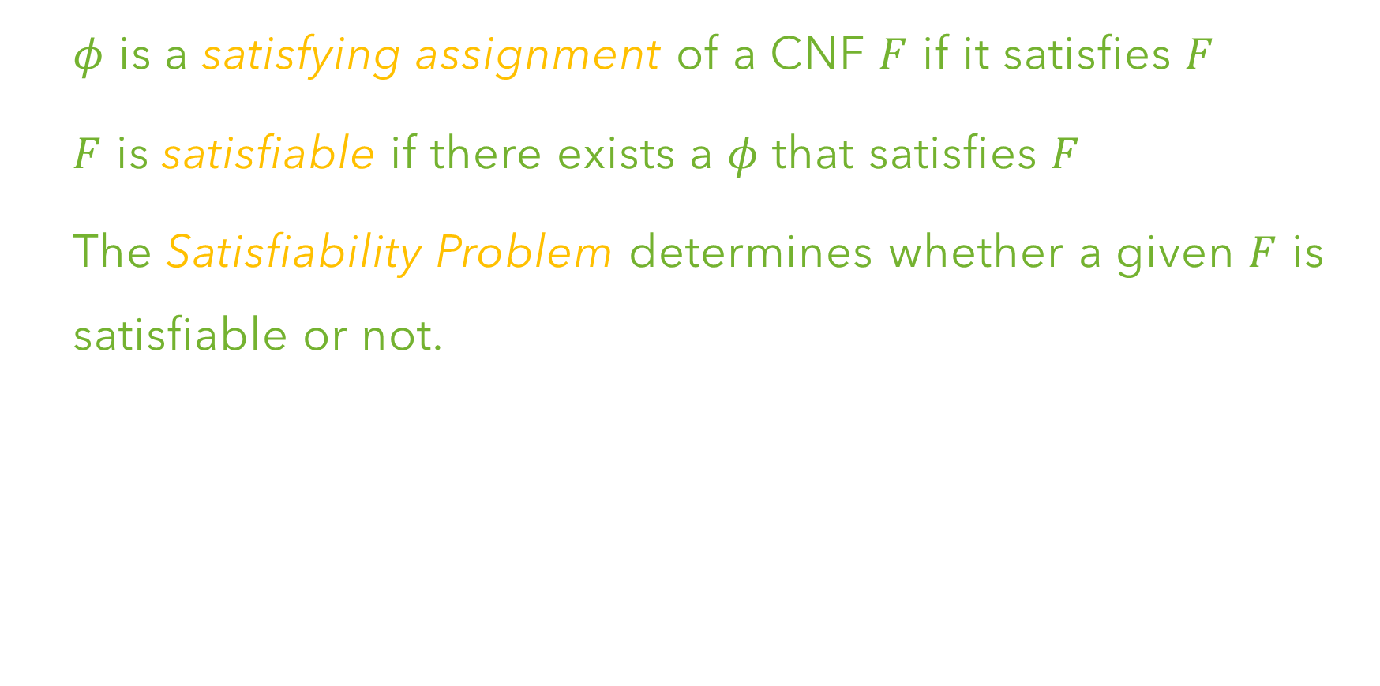
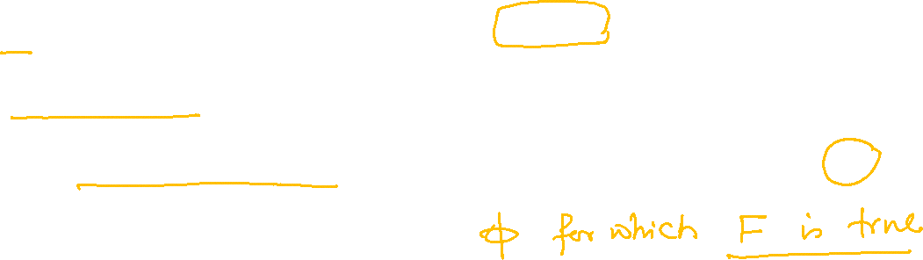
Satisfiability
$φ$ is a satisfying assignment of a CNF $F$ if it satisfies $F$
$F$ is satisfiable if there exists a $φ$ that satisfies $F$
The Satisfiability Problem determines whether a given $F$ is satisfiable or not.

Slide 7
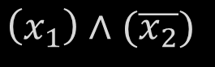
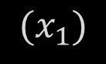
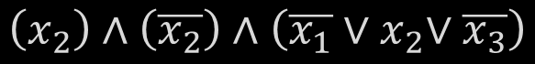
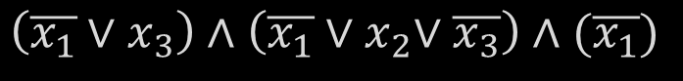
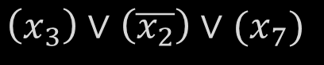
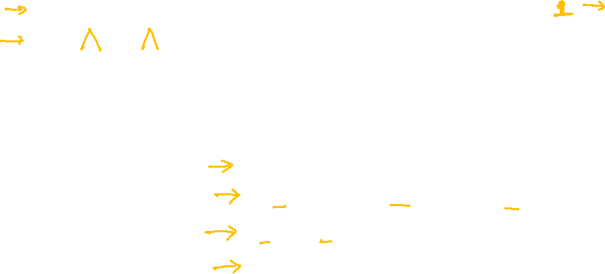
Satisfiability: Example
Satisfiable Formula
Unsatisfiable Formula
$$(x_{1})$$
$$\left(x_{1}\right)∧(\overline{x_{2}})$$
$$\left(x_{3}\right)∨\left(\overline{x_{2}}\right)∨(x_{7})$$
$$\left(\overline{x_{1}}{∨x}_{3}\right)∧\left(\overline{x_{1}}{∨x}_{2}∨\overline{x_{3}}\right)∧(\overline{x_{1}})$$
$$\left(x_{2}\right)∧\left(\overline{x_{2}}\right)∧\left(\overline{x_{1}}{∨x}_{2}∨\overline{x_{3}}\right)$$
$$\left(x_{1}∨x_{2}\right)∧\left(x_{1}∨\overline{x_{2}}\right)∧\left(\overline{x_{1}}∨ \overline{ x_{2}}\right)$$

Slide 8
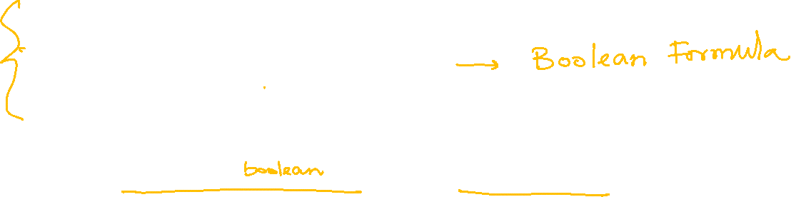
Satisfiability: Scheduling Meeting
A can only meet on Monday or Wednesday
B cannot meet on Wednesday
C cannot meet on Friday
D can only meet on Thursday or Friday
SAT problem instance
$$F=\left(x_{1}∨x_{3}\right)∧\left(\overline{x_{3}}\right)∧\left(\overline{x_{5}}\right)∧(x_{4}∨x_{5})∧AtMostOne(x_{1},x_{2},x_{3},x_{4},x_{5})$$

Slide 9
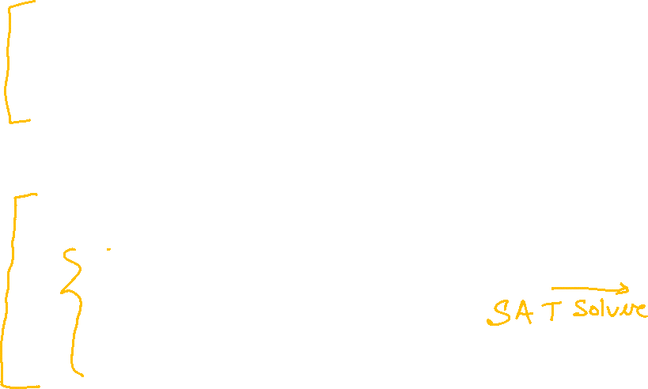


Satisfiability: Scheduling Meeting
A can only meet on Monday or Wednesday
B cannot meet on Wednesday
C cannot meet on Friday
D can only meet on Thursday or Friday
SAT problem instance
$$F=\left(x_{1}∨x_{3}\right)∧\left(\overline{x_{3}}\right)∧\left(\overline{x_{5}}\right)∧(x_{4}∨x_{5})$$
$$∧ \left(\overline{x_{1}}∨\overline{x_{2}}\right)∧\left(\overline{x_{1}}∨\overline{x_{3}}\right)∧\left(\overline{x_{1}}∨\overline{x_{4}}\right)∧\left(\overline{x_{1}}∨\overline{x_{5}}\right)$$
$$∧ \left(\overline{x_{2}}∨\overline{x_{3}}\right)∧\left(\overline{x_{2}}∨\overline{x_{4}}\right)∧\left(\overline{x_{2}}∨\overline{x_{5}}\right)$$
Unsatisfiable
$$∧ \left(\overline{x_{3}}∨\overline{x_{4}}\right)∧\left(\overline{x_{3}}∨\overline{x_{5}}\right)$$
$$∧ \left(\overline{x_{4}}∨\overline{x_{5}}\right)$$

Slide 10

Hardness of SAT
SAT is NP-Complete
No polynomial time algorithm for SAT yet
Known complete algorithms have exponential runtime in worst case

Slide 11
Applications of SAT
Hardware Model Checking
Does a circuit exhibit intended behavior?
Verify chip design (e.g., intel)
Software Verification
SMT solvers to verify Microsoft products
Verification of embedded software in cars, airplanes etc.
One of the best approaches in planning and scheduling
Number theoretic problems
Connection with NP-hard problems

Slide 12

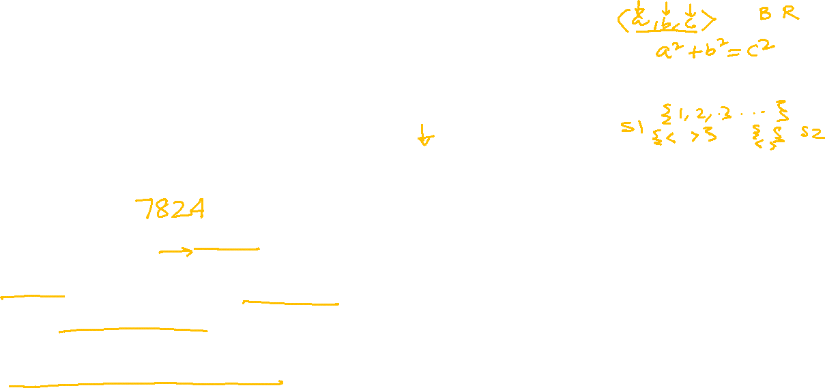
SAT Encoding: Pythagorean Triple
Can the set of integers {1,2,3,….,} be partitioned into two sets such that no part contains a Pythagorean triple ($a,b,c∈ℕ$ st $a^{2}+b^{2}=c^{2}$)?
Is it possible to assign each integer one of two colors such that if $a^{2}+b^{2}=c^{2}$ then $a,b,c$ do not all have the same color?
Not possible for 7825
Proof obtained by a SAT solver
has 200 Terrabytes
Largest math proof ever

Slide 13
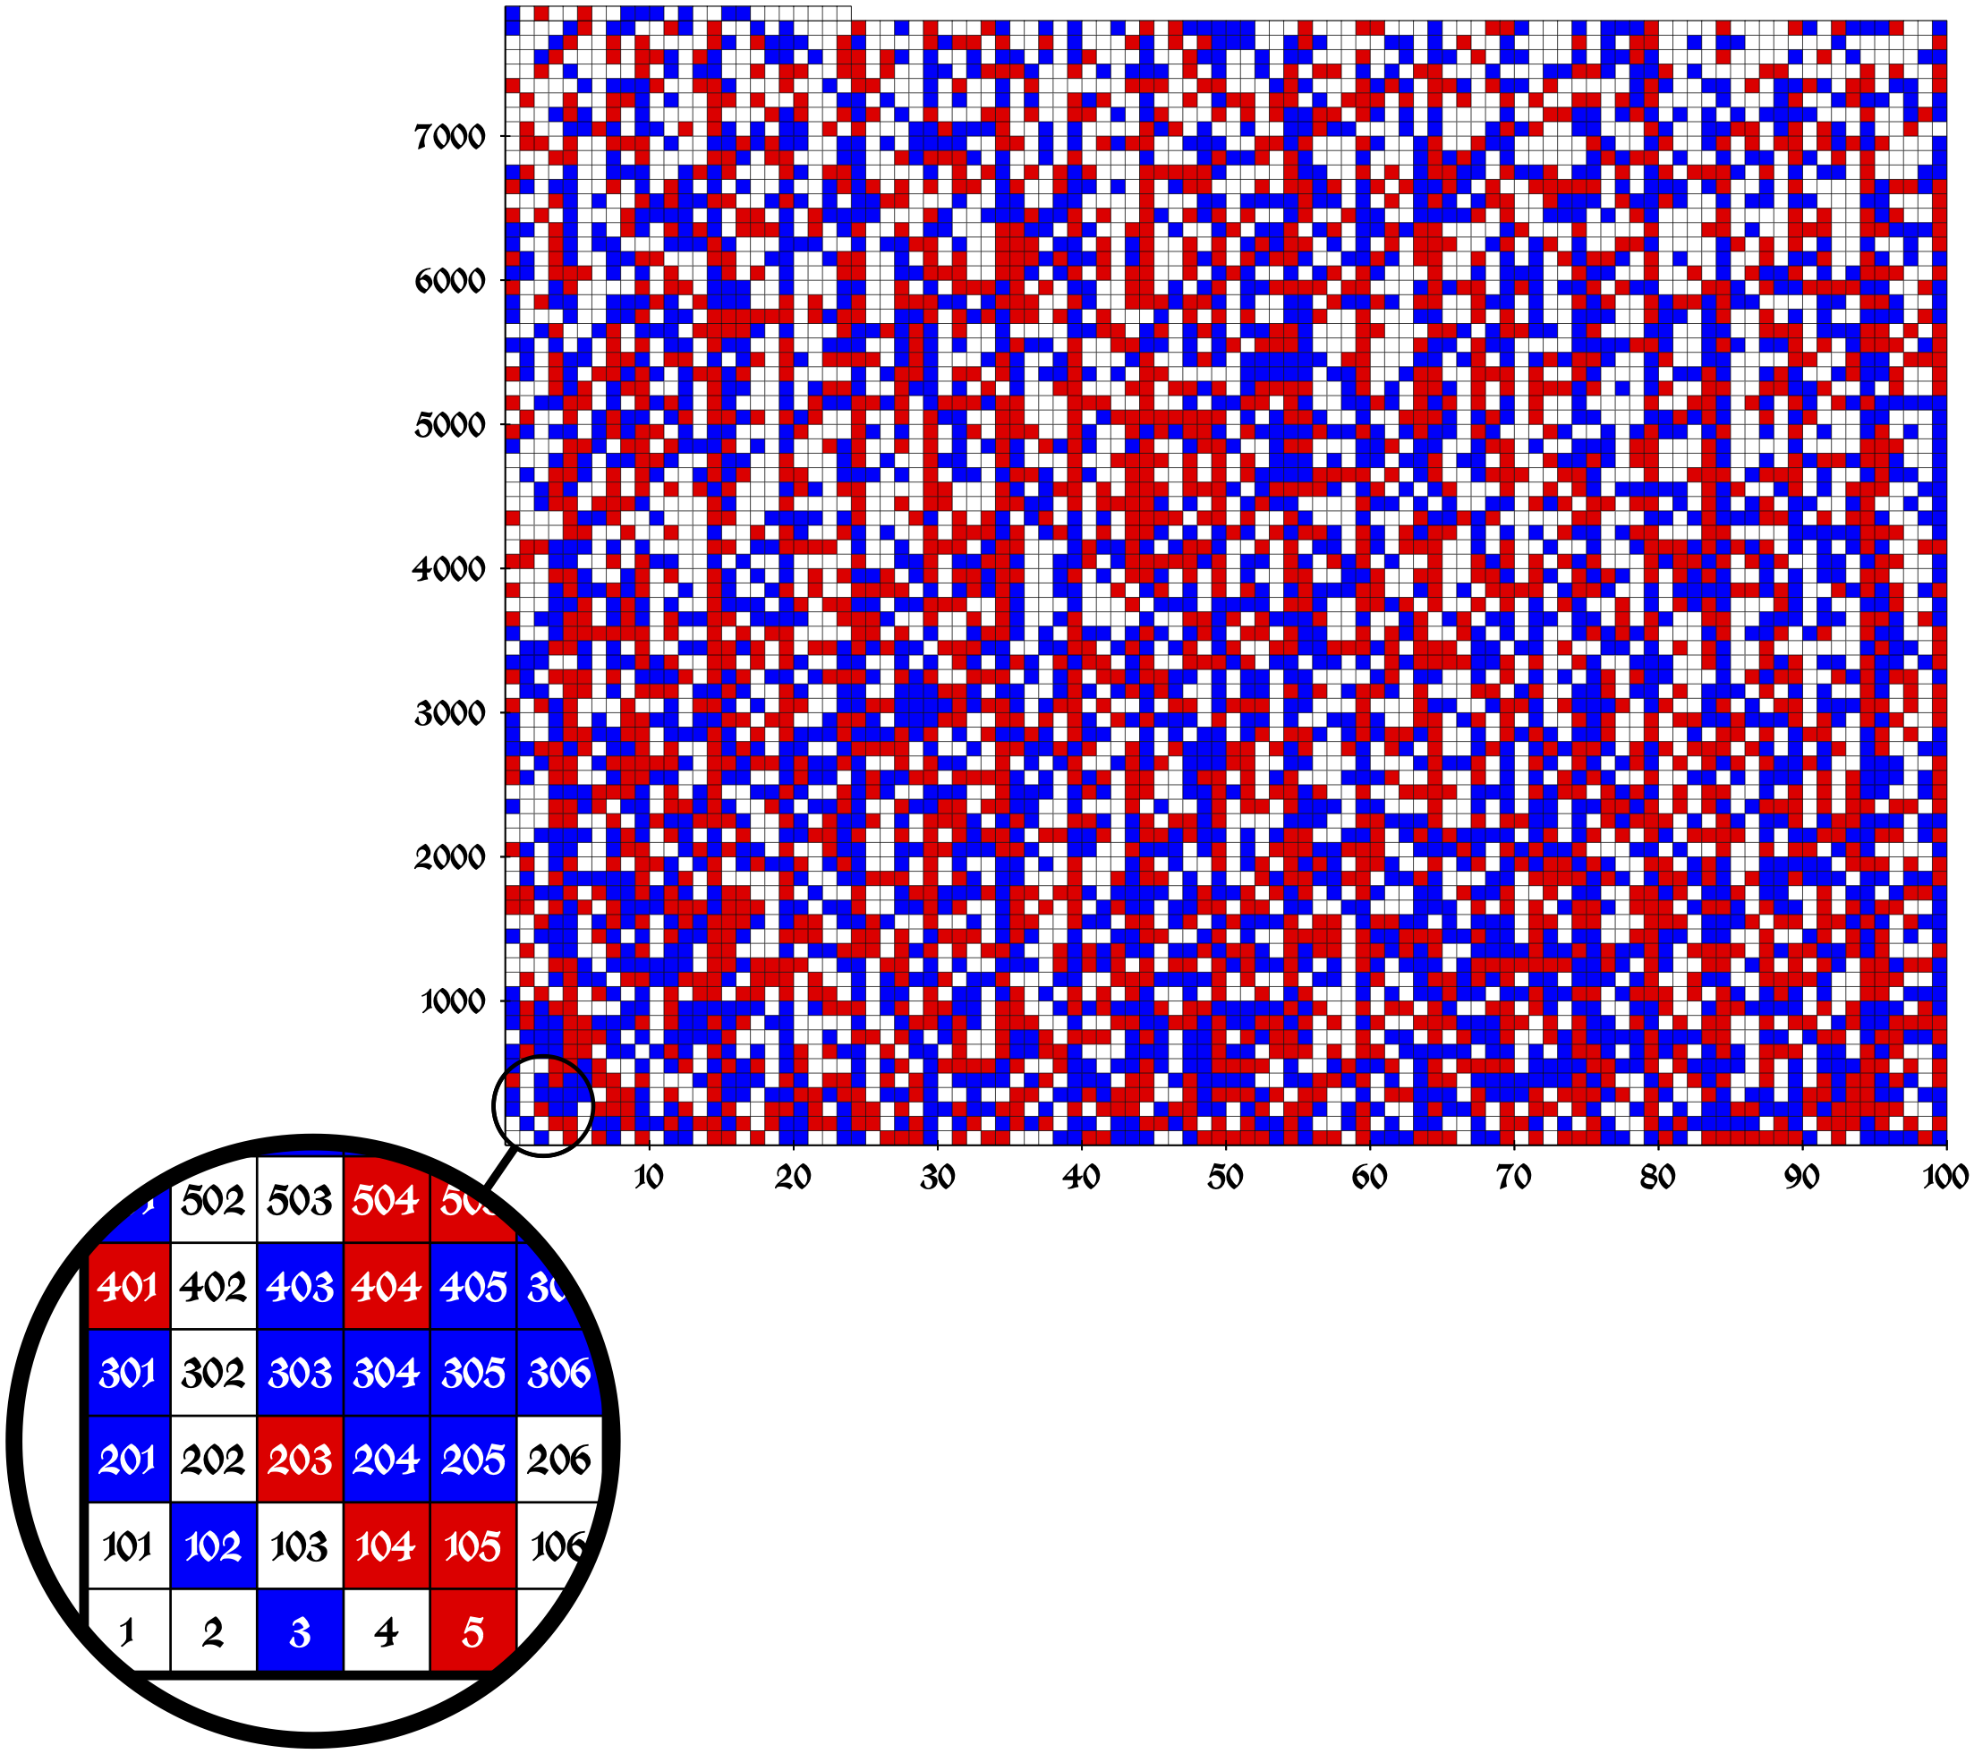
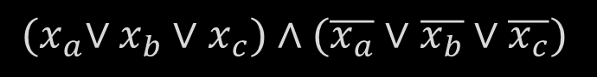
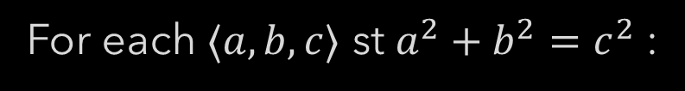
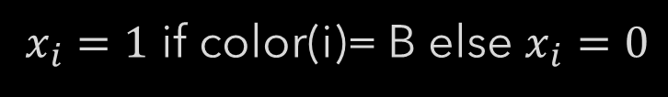
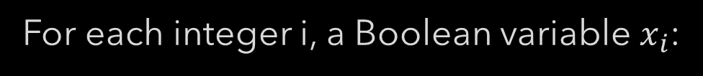
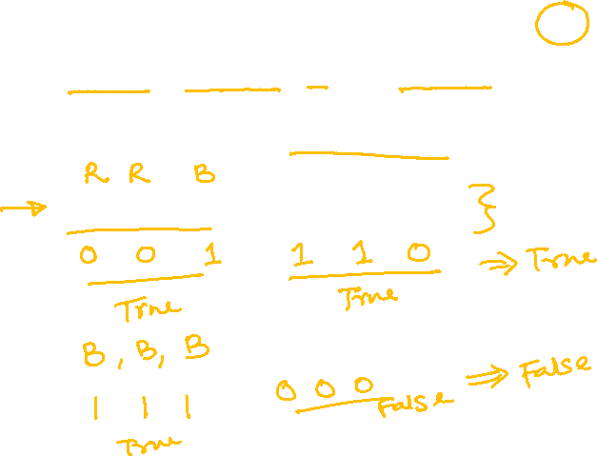
SAT Encoding: Pythagorean Triple
Is it possible to assign each integer one of two colors such that if $a^{2}+b^{2}=c^{2}$ then $a,b,c$ do not all have the same color?
For each integer i, a Boolean variable $x_{i}$:
$x_{i}=1$ if color(i)= B else $x_{i}=0$
For each $⟨a,b,c⟩$ st $a^{2}+b^{2}=c^{2}$ :
${(x}_{a}∨x_{b}∨x_{c})∧(\overline{x_{a}}∨\overline{x_{b}}∨\overline{x_{c}})$
https://www.nature.com/articles/nature.2016.19990

Slide 14
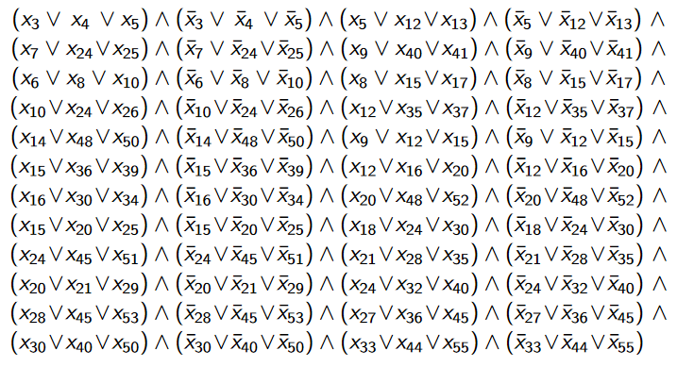
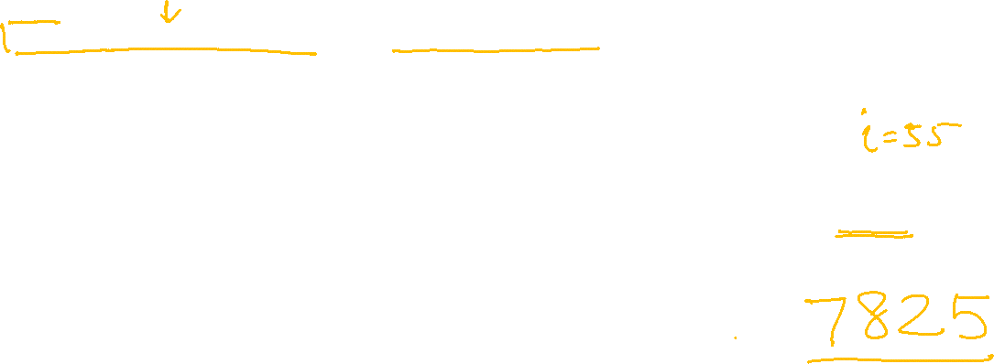
SAT Encoding: Pythagorean Triple
Is it possible to assign each integer one of two colors such that if $a^{2}+b^{2}=c^{2}$ then $a,b,c$ do not all have the same color?
N=55

Slide 15
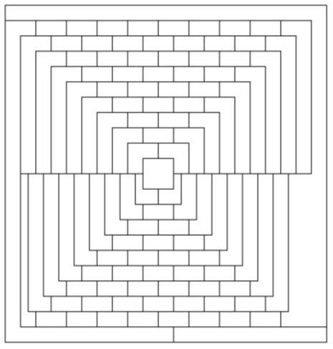
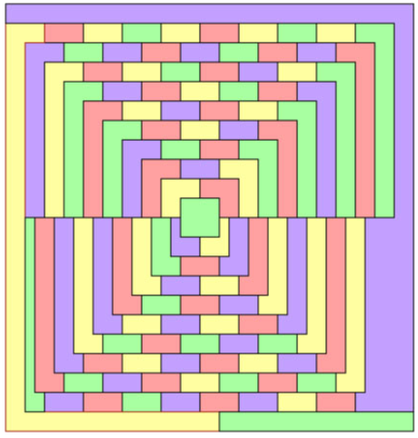

SAT Encoding: Graph Coloring
McGregor graph (of order 10): planar, 110 nodes
Cannot be colored with less than 5 colors

Slide 16
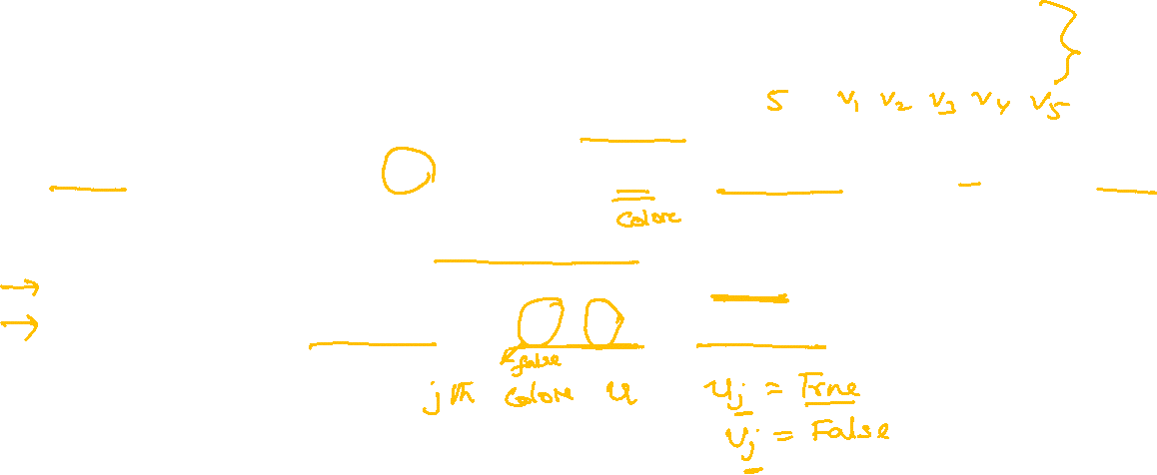
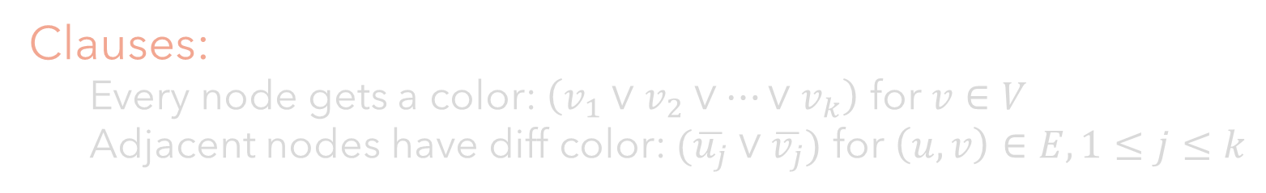
SAT Encoding: Graph Coloring
A graph coloring using at most $k$ colors is called $k$-coloring. The Graph Coloring Problem seeks whether $k$-coloring for a graph $G=⟨V,E⟩$ exists.
Variables:
$k.|V|$ Boolean variables $v_{j}$ for $v∈V, 1≤j≤k, v_{j}=True$ if node $v$ gets color j
Clauses:
Every node gets a color: $\left(v_{1}∨v_{2}∨…∨v_{k}\right)$ for $v∈V$
Adjacent nodes have diff color: $(\overline{u_{j}}∨\overline{v_{j}})$ for $\left(u,v\right)∈E, 1≤j≤k$

Slide 17

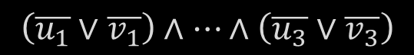



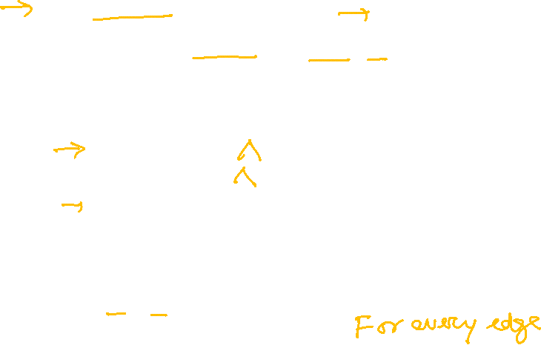


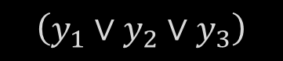


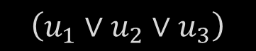


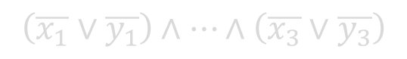
SAT Encoding: Graph Coloring
$$V=\{u,v,w,x,y\}$$
$$k=1,2,3$$
$$Variables=\{u_{1}, u_{2}, u_{3}, …, y_{1},y_{2}, y_{3}\}$$
Clauses:
Every node gets a color:
Adjacent nodes have diff color:
$$u$$
$$\left(u_{1}∨u_{2}∨u_{3}\right)$$
$$…………$$
$$\left(y_{1}∨y_{2}∨y_{3}\right)$$
$$v$$
$$w$$
$$\left(\overline{u_{1}}∨\overline{v_{1}}\right)∧…∧\left(\overline{u_{3}}∨\overline{v_{3}}\right)$$
$$x$$
$$y$$
$$…………$$
$$\left(\overline{x_{1}}∨\overline{y_{1}}\right)∧…∧\left(\overline{x_{3}}∨\overline{y_{3}}\right)$$

Slide 18
SAT Solvers

Slide 19
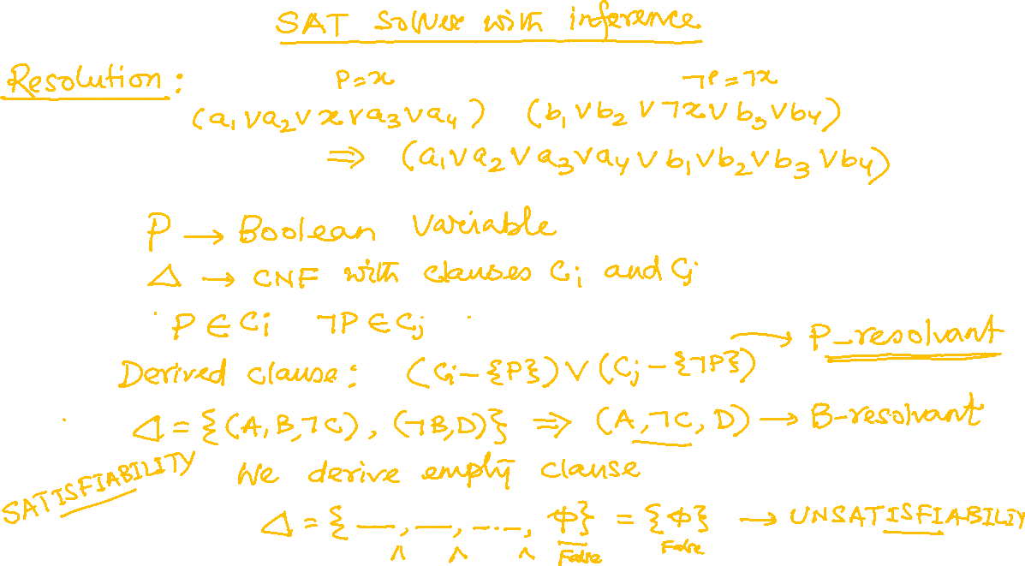

Slide 20
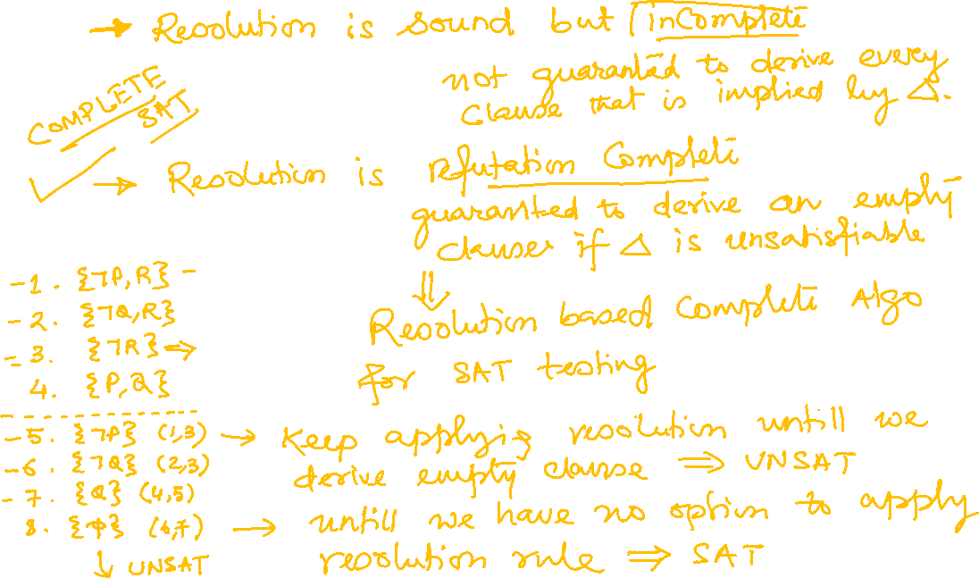

Slide 21
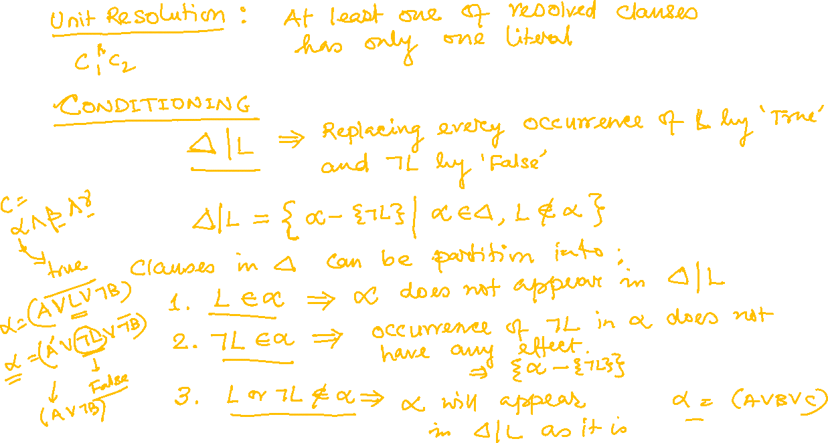

Slide 22
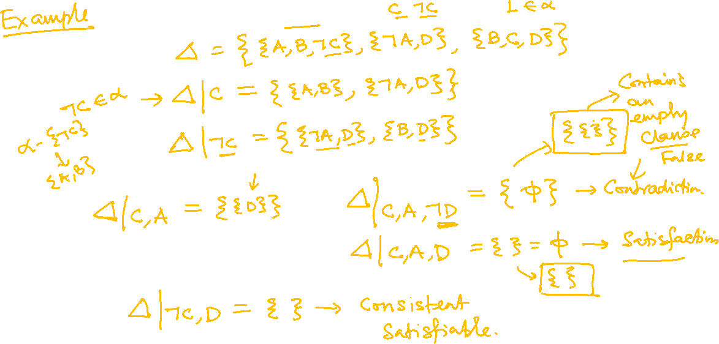

Slide 23
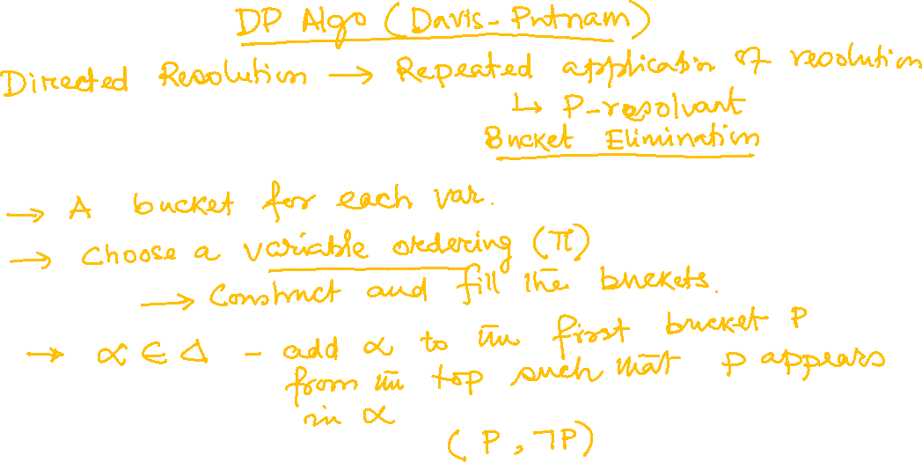

Slide 24
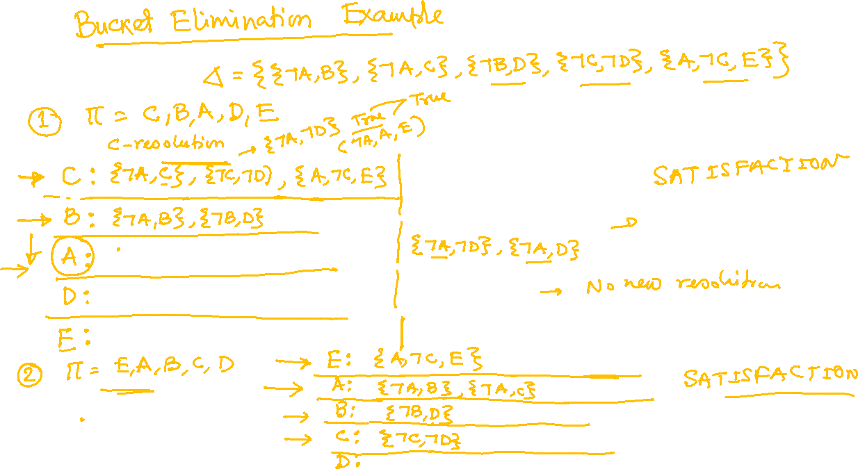

Slide 25
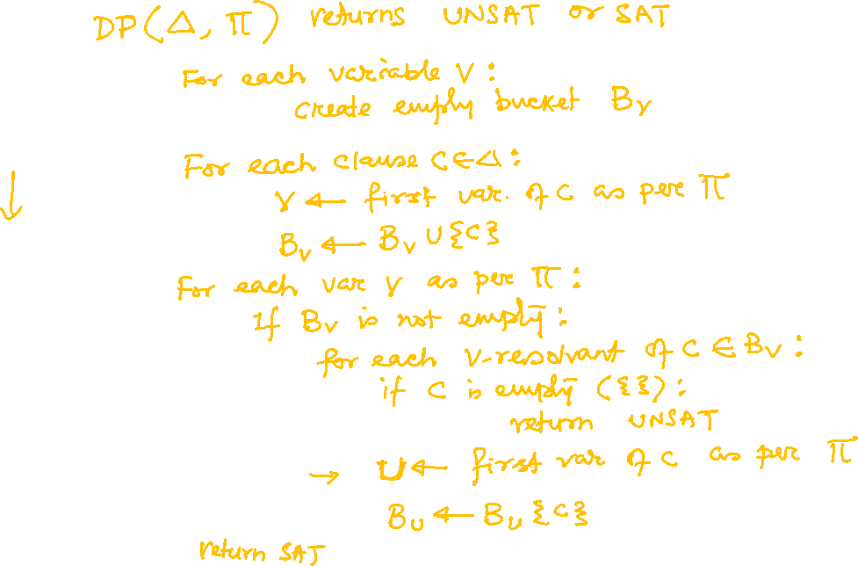

Slide 26
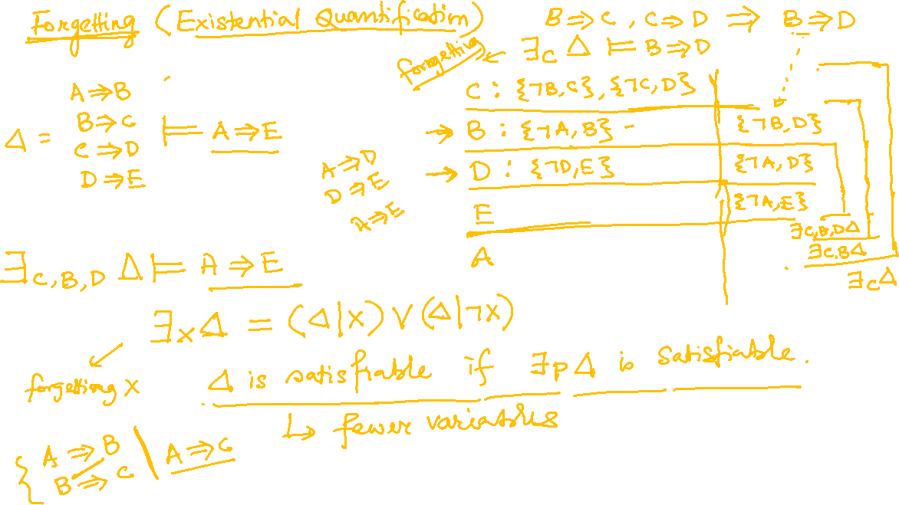

Slide 27
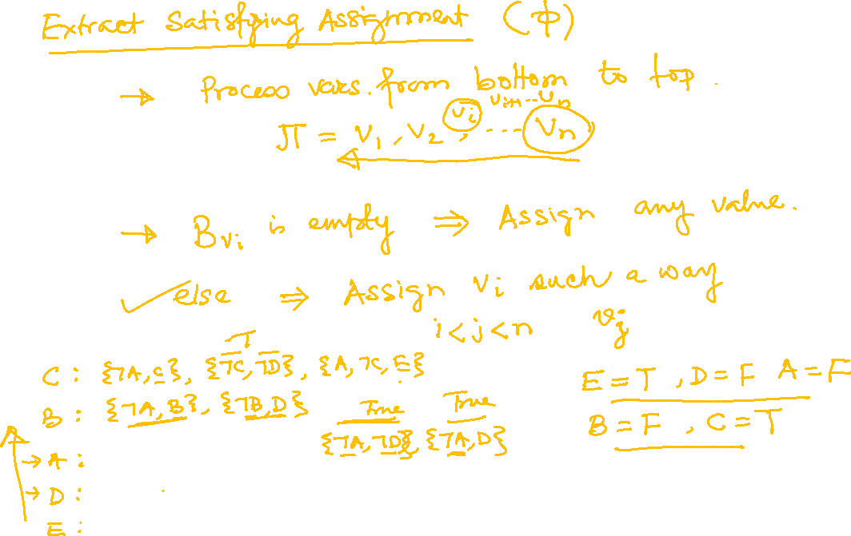

Slide 28
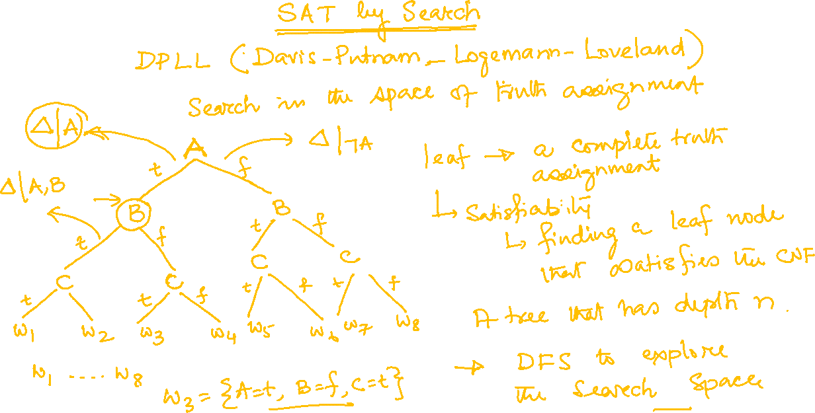

Slide 29
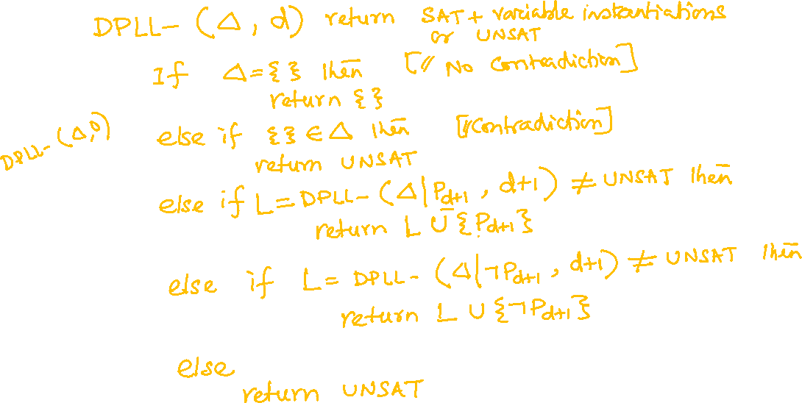

Slide 30
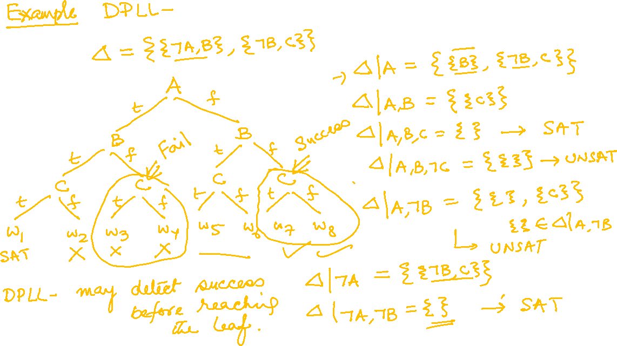

Slide 31
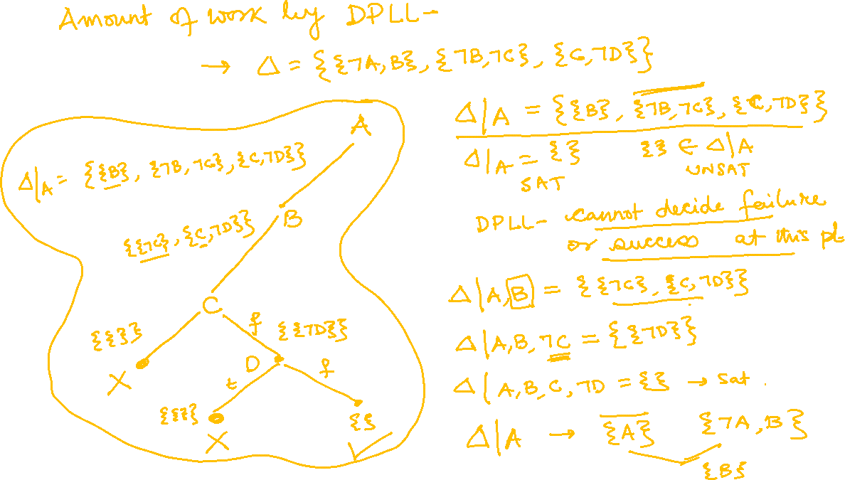

Slide 32
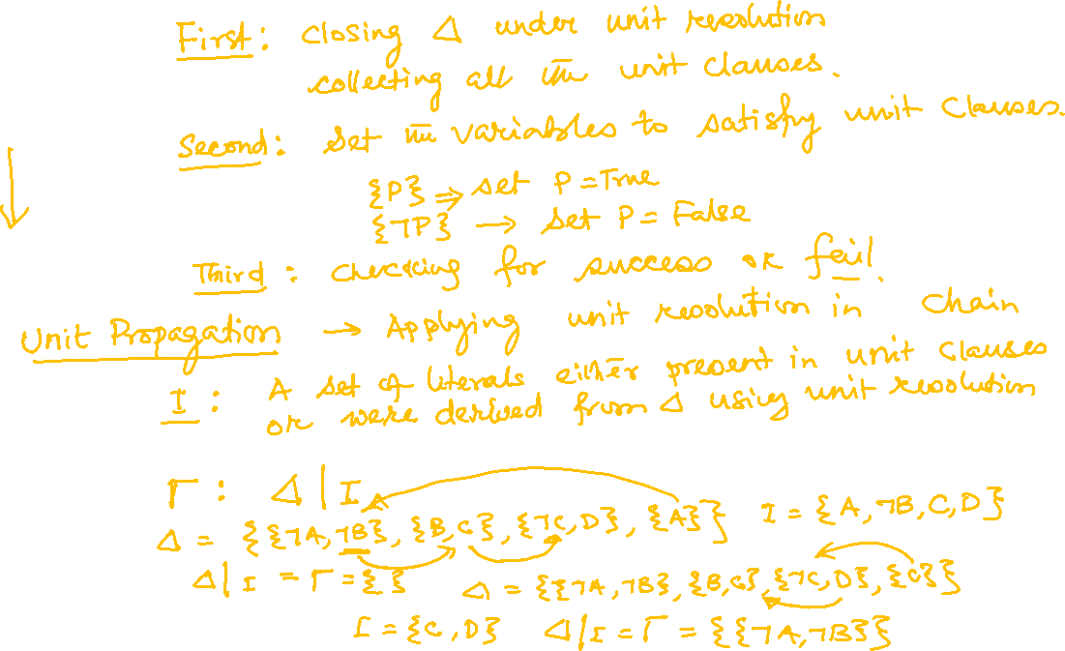

Slide 33
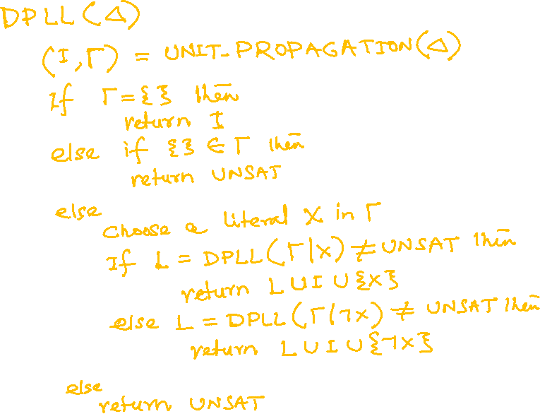

Slide 34


Slide 35


Slide 36


Slide 37


Slide 38


Slide 39


Slide 40


Slide 41


Slide 42


Slide 43


Slide 44


Slide 45


Slide 46


